Slide 1
How did the U.S. Become Globally Connected?
Imperialism & World War I
1898—1919

Slide 2
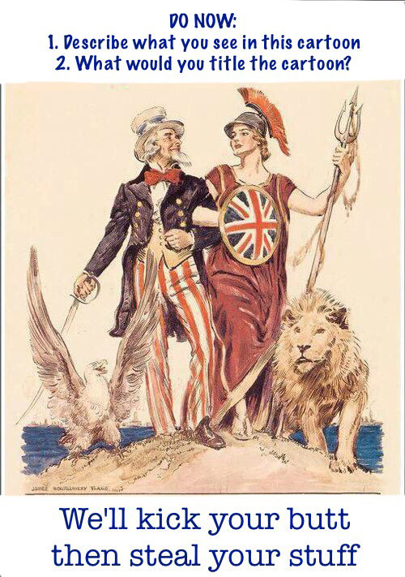

Slide 3
America's Foreign Policy
Foreign policy has been neutrality since George Washington.
Foreign policy changed between 1890 and 1919
The U.S. Wanted to expand its growing empire, protect trading interests, and secure territories around the globe
This was all about political and economic gain
What does it sound like the U.S. is going to become?

Slide 4
Why do Nations Imperialize?
Money—to capitalize on the rich natural resources
Ex: gold, ivory, jewels
God—to convert to Christianity those seen as “savages”
Social Darwinism—White Man's Burden
Market—Heavily populated areas ideal for selling goods
India & China were the most populated

Slide 5
Emerging Global Involvement
New Technology
Improvements in transportation & communication shortened distances around the world
Railroads connect factories & farms and East Coast to West Coast
The world was becoming more interdependent

Slide 6
Emerging Global Involvement
Drive for Raw Markets and Raw Materials
Economics linked foreign & domestic policy
Both businesses & farmers wanted overseas markets to provide economic stability
International competition with Europe over raw materials and markets dramatically increased

Slide 7
Emerging Global Involvement
Growth of Naval Power
U.S. Navy expanded
Built steel warships with steal engines–the latest weapon
As foreign trade grew, a nation need a strong navy to protect its goods
In turn the navy needed bases to refuel and restock supplies

Slide 8
The U.S. in the Pacific: China
U.S. Began trade with China in the 1780s
Now the U.S. worried trade would be limited due to;
Spheres of Influence—An area of one country under the control of another. In China, these areas guaranteed specific trading privileges to each imperialist nation within its respective sphere.

Slide 9
The U.S. in the Pacific: China
Open Door Policy
To ensure economic opportunity, U.S. Secretary of State John Hay asked European powers to keep an "open door" to China
Gave the U.S. Fair access to the Chinese market
Boxer Rebellion
Chinese society revolted against missionaries, diplomats & foreigners, the intervention of Western powers.

Slide 10
Analyze the Document
"The policy of the United States is to seek a solution which may bring about permanent safety and peace to China, preserve Chinese territorial and administrative entity, protect all rights guaranteed to friendly powers by treaty and international law and safeguard for the world the principle of equal and impartial trade with all parts of the Chinese Empire."
Open Door Policy, 1899
Is this policy different from the principles of the Monroe Doctrine?
Why was it in American self-interest to call for the preservation of Chinese territorial & administrative integrity?

Slide 11
The U.S. in the Pacific: Japan
Japan's isolation ended in 1854 that is to Commodore Mathew Perry
Japan modernized and become an economic power by 1900
U.S. Goal from 1900-1941: restrict Japanese expansion
Root-Takahira Agreement
Both countries agrees to uphold the Open Door Policy and not attempt to seize the other's possessions

Slide 12
The U.S. in the Pacific: Hawaii
U.S. Placed a protective tariff on Hawaiian sugar so that domestic sugar would be purchased (because it would be cheaper)
Planters in Hawaii lost money
Hawaiian nationalism grew and became the Republic of Hawaii
Hawaii did not become part of the U.S. until 1898
Became and important military and commercial link to East Asia and the Philippines

