Slide 1
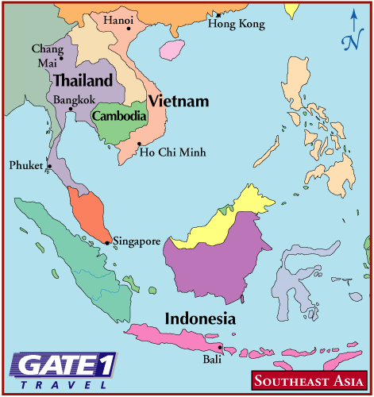
Southeast Asia

Slide 2
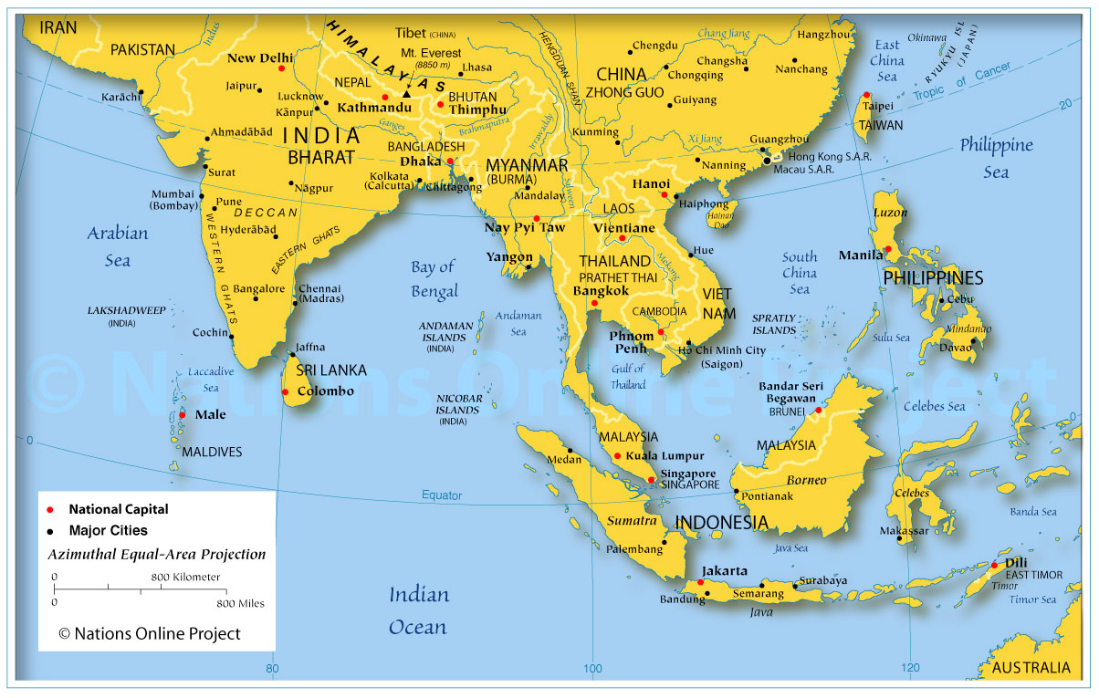
Region Geography
Southeast Asia
Region 1-Mainland: Myanmar, Cambodia, Laos, Vietnam, Thailand, India, China
Region 2- Islands: 20,000- Indonesia, Singapore, Brunei, Philippines

Slide 3
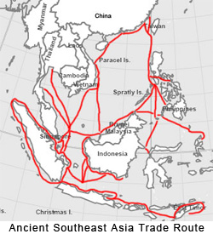
Political Overview
Power= Control of Trade Routes and Harbors
Strait of Malacca
Sundra Strait
Trade
Monsoons= Indian Traders (Religion, Language and Art)
China= political influence (direct rule or tribute)

Slide 4
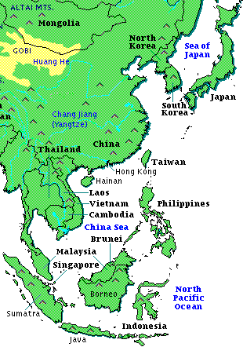

Slide 5
Cambodia

Slide 6
Khmer Empire
Politics
Reached height in 1200
Centralized= irrigation systems and waterways
Economics
Rice cultivation
Trade (TAX)
Religion (Architectural Beauty)
Angkor Wat- Hindu Temple
Borobudur- Buddhist Temple

Slide 7
Khmer Rouge
Cause
Effect
Vietnam War
Cambodia was a casualty
Supplies for guerrilla forces transferred through Cambodia and America bombed it
Led to instability and Khmer Rouge (Communist) overthrew the government)
Pol Pot
Reign of Terror
Destroy all Western Influence
People forced to work in fields
“Killing Fields”

Slide 8
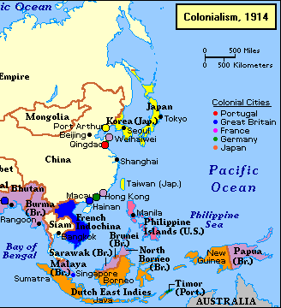
Imperialism Southeast Asia

Slide 9
Pre Industrial Revolution Imperialism
India and China Influence
Politics, Language, Religion
European Merchants
Desire for Trade NOT COLONIZATION

Slide 10
Post Industrial Revolution Imperialism
Industrial Revolution: 1+7=8 0
Natural Resources, Land, People= COLONIZATION
Dutch East India Company: Moluccas (Spice Islands)- Coffee, Indigo, Spices
British East India Company: Burma, Malay Peninsula (Singapore)- Rubber, Tin
French Indochina: Vietnam, Laos, Cambodia- Christianity
Thailand: Kingdom of Siam, Independent- accepted unequal treaties, modernization, training from “Western Experts”… yet Sphere of Influence

Slide 11
Post WW2 Southeast Asia
Unity
Association of Southeast Asian Nations (ASEAN)
Imperialistic Powers Leave
Self- Interest (ex. France leaves Indochina)
Internal Struggles for Power
Religion unites and divides (Hinduism, Buddhism and Islam= cultural diffusion)
Economic hardship (increased population but scarcity of resources and slow economic growth)
Cold War (Communism- Karl Marx)
1970’s and 1980’s: increased industrialism
Conflict
Vietnam War= communist win, topography, Ho Chi Minh takes control
Cambodia= Khmer Rouge, Pol Pot, genocide

Slide 12
Vietnam

Slide 13
Geography
Southeast Asia
Region 1- Mainland: Myanmar, Cambodia, Laos, Vietnam, Thailand, India, China
Region 2- Islands: 20,000- Indonesia, Singapore, Brunei, Philippines
Vietnam: South of China, East of Cambodia
Red River Delta
Irrigates Northern Vietnam (rice padis)

Slide 14
Chinese Influence
Influence from China during the Han Dynasty
Tang Dynasty- Broke away= Kingdom of Dai Viet
Shared Ideas= Government, Confucianism, Mahayana Buddhism, nobles spoke Chinese (large dragon vs. small dragon)
Independent Ideas= Women more freedom, Trung Sister resistance

Slide 15
Colonization
French Indochina
Early 1800’s France started influence with missionaries- resistance failed
1860’s France colonized all of Vietnam, Laos and Cambodia

Slide 16
Independence Movement
1930’s- Led by Ho Chi Minh (Communist- Vietminh)
1941- Under Japanese Control (WW2)
JAPAN FORCED OUT IN 1945
Fight for Independence from France!!
Nationalists and Communists unite
Supported by the USA
Hit and Run tactics, support for Vietminh- VICTORY at Dien Bien Phu

Slide 17
Vietnam Divided
Geneva Agreement (1954)
Domino Theory
Vietnam divided at 17 degrees north latitude (North= Communism= Ho Chi Minh, South= Anti-communist= Ngo Dinh Diem)
Ho Chi Minh North
Totalitarian government
Land reform= peasant support
Vietcong- guerilla communists opposed to Diem dictatorship (fear open elections would lead to communist victory)
1963= Diem assassination, military coup

Slide 18
Vietnam War
Gulf Of Tonkin- supposed attack on USA destroyers by North Vietnamese
Resolution- Congress authorizes Johnson to send troops to Vietnam
American Troubles
Guerilla war on unfamiliar terrain
Bombing= support for Communists
South Vietnam government (Diem) unpopular
North Vietnam supported by China and Soviet Union
Vietnamization (1972)
America pulls out giving South greater role
Massive bombing campaigns in Indochina

Slide 19
Post War Vietnam
North Victory
Tight control of South
Reeducation camps
Government control of business
5 Year Plans- failure led to policy change in economics
Oppression

Slide 20
Philippines

Slide 21
Filipino Nationalism
1500’s controlled by Spain
1800’s revolt against Church abuse of power and wealth
Incidentally 19898 war between US and Spain… US destroys Spanish fleet in Philippines.. INDEPENDENCE!!!..... NO… America takes over
Emilo Aquinaldo fought for independence but loses. America promises self rule in the future.
1946 Democratic Government established but elite controlled politics and economics
Huks- local communists who wanted reform but America helped crush rebellion
“People Power” Revolution- Corazon Aquino

