Slide 1
Regents Review
Middle East

Slide 2
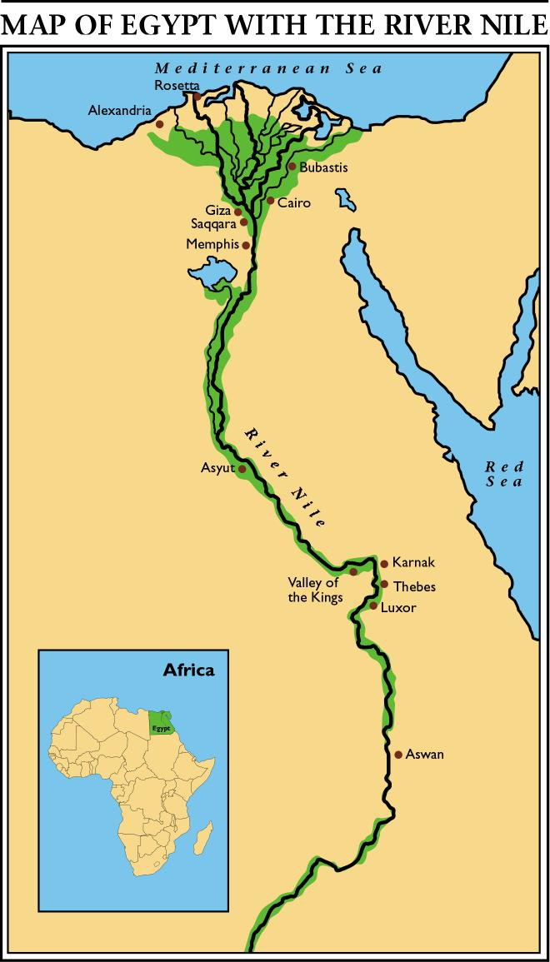
Early Human Society
Nomads
Moving from place to place
Neolithic Agricultural Revolution
Nomad (temporary) to Farmer (permanent)
Ancient Egyptian civilization
began to develop along the
Nile River Valley in Africa around 3,000BC

Slide 3
River Valley Civilizations
Mesopotamia (Tigris and Euphrates River Valley: Why?)
Sumerians
Inventions: Tools, Written Language (Cuneiform), #60
Babylonians
Hammurabi Code- Code of Law, Eye for an Eye
Hittites
Iron
Lydians
Coins
Phoenicians
Traded goods and ideas
First Alphabet
Hebrews
Judaism
Monotheistic (commonality with Christianity and Islam)
Chaldeans
Babylon- Hanging Gardens
Persians
Empire= India to Egypt
Justice and Fairness

Slide 4
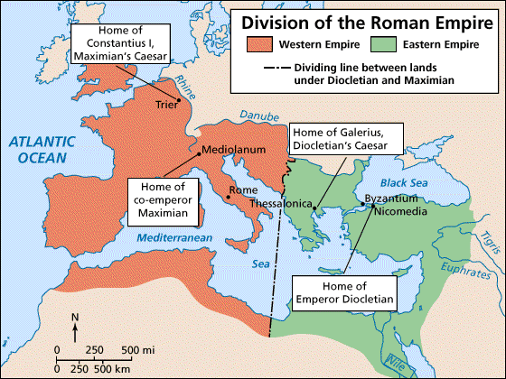
Byzantine Empire (330- 1453)
Eastern Rome- Byzantine Empire (306-1453)
Location= Trade, Crusades- Cultural Diffusion
Eastern Orthodox Church= No Icons
Constantinople
Preservation of Rome and Greek culture (ex. Justinian Code)

Slide 5
Islamic Expansion Rise of Islam
Founder: Mohammad
Monotheism: Belief in ONE GOD
Holy Book: Koran (Qur’an)
Allah: God
Jihad
Holy War
5 Pillars
Declaration of Faith
Prayer 5x
Almsgiving
Hajj
Fasting (Ramadan)
Hijra
From Medina to Mecca… Start of Islam

Slide 6
Islamic Expansion Golden Age and Decline
Accomplishments and Golden Age
Advances in science, literature and mathematics
Expansive Territory (Europe, Africa and Asia)
Tolerance of other religions and cultures
Preserve Greek and Roman learning
Decline
Crusades (1096) Conflict over Holy Land: Jerusalem
Sense of purpose
Tensions between Muslims and Christians
Disunity
Sunni- this group believes that religious leaders should get their guidance from the Koran (majority)
Shiites- religious leaders must be descended from Mohammed’s line and get their guidance from the original light of Mohammed’s revelation (minority)
Trade Routes
Cultural Crossroads
European Power

Slide 7
Ottoman Empire (1453- 1918)
Ottoman Turk Expansion
Suleiman the Magnificent
Expansive Empire
Fostered Arts and Literature
Decline of the Ottoman Empire
WW 1
Territory divided amongst Allies
British and French Mandates

Slide 8
Middle East in the 20th Century
Cultural Identity
Diversity
Geography
Mostly Arid
Diversity= unequal wealth
Oil in the Middle East
Trade
OPEC- unite to have more power in world market
Wealth
Modernization vs. Tradition
Importance of Water Routes
Suez Canal Conflict (1956)
Britain, Israel, France vs. Egypt: Canal was important for trade between Europe and Asia
Persian Gulf War (1990)
In 1990, Saddam Hussein invaded Kuwait : “slant drilling” (stealing oil)
Coalition of European and Arab powers led by the United States went to the Persian Gulf to drive Iraqi forces out of Kuwait

Slide 9
Middle East in the 20th Century Arab/ Israeli Conflict
Zionism (Balfour Declaration 1917)
Desire for a Jewish State- conflict with Arab Goal
War of Independence (1948)
Success!.... Now maintain security.
Nationalism (Cause of Conflict- Arab vs. Jew)
PLO- Palestinian Liberation Organization, Terrorism
Uneasy Peace
Camp David Accords (Sadat and Begin)
Egypt and Israel- Negotiate
Obstacles for Arab Success
Disunity
War

Slide 10
Middle East in the 20th Century Arab Conflict
Iranian Revolution 1979 (within)
Causes
Shah not meeting social and political needs of people (repression)
Western Ideas (Shah) vs. Tradition (people)
Results
Overthrown by Imam (religious leader) Ayatollah Khomeini FUNDAMENTALISM
Iran became Islamic fundamentalist state and a THEOCRACY
Anti-American attitude resulted in end of US/Iran relations
52 Americans taken hostage in Iran
1981: Ronald Regan is inaugurated hostages were freed

Slide 11
Middle East in the 20th Century Arab Conflict
Iran- Iraq War 1980’s (between)
Causes
Iran and Iraq often fought over territory.
Also Iraqi leaders were mostly Sunni Muslims while Iranians were mostly Shiite Muslims
Results
Slow down of economic growth in both countries
Iraq’s invasion of Iran results in 1,000,000 dead, oil reserves destroyed and Saddam Hussein’s attack on other neighboring countries
Also sets the stage for Saddam’s attacks on his own people, especially the Kurds

