Slide 1
Latin America
Regents Prep

Slide 2
Latin American Geography
Diverse Physical Features
Mountains (Andes)= tough to unify area
Rainforest (Brazil)
Aquatic/ Tropical (Central America)

Slide 3
Ancient Civilizations in Latin America
Ancient Civilizations
Mayan Empire
(Central America)
Incan Empire
(Peru)
Aztec Empire
(Mexico)

Slide 4
Ancient Civilizations: Aztec

Slide 5
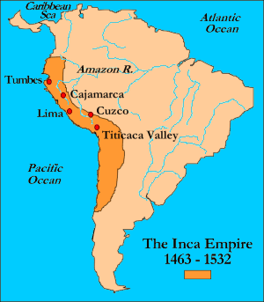
Ancient Civilization: Inca

Slide 6
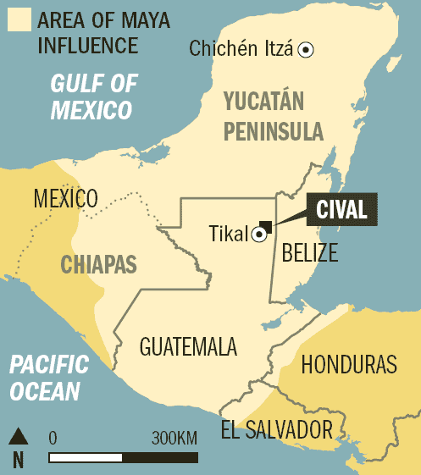
Ancient Civilization: Mayan

Slide 7
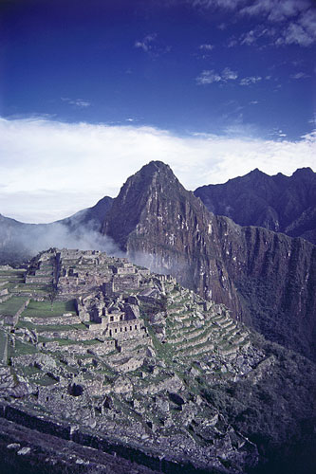
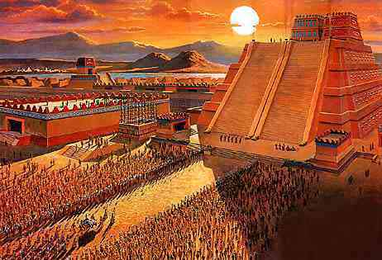
Ancient Civilization Accomplishments and Decline Aztecs, Incas, Mayans
Complex math and calendar system= accomplishments rivaled Middle East (Islamic) achievements
Complex cities, governments, writing
Flourishing pre-European contact
Adapted to environment
Incas (Andes)= footbridges and road
Aztec= floating gardens
Decline of Empires
Disease
Conquistadors
Cortes/Aztecs
Pizarro/Incas
Impact of Pre-Columbian civilization can be found in modern art and architecture

Slide 8
Colonial Rule
Latin America

Slide 9
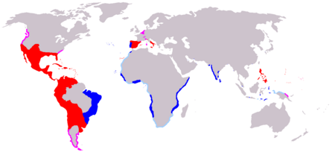
Colonial Rule in Latin America
Colonial Powers
Spain
Portugal
(Treaty of Tordesillas)

Slide 10
Colonial Rule in Latin America ECONOMIC FACTORS
Concentration of power in a small group and landowners (mostly Spanish descendents)
Encomienda System
Result of Age of Exploration
Slaves forced into labor (scarcity of natives)
Mercantilism
Colonies are for raw materials and to purchase manufactured goods
Led to production of raw materials and cash crops
Columbian Exchange- economic growth, new goods, new ideas

Slide 11
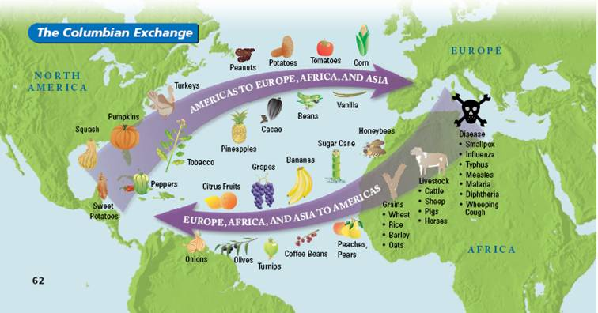
Columbian Exchange

Slide 12
Colonial Rule in Latin America SOCIAL FACTORS
Emphasis on military and strength of Roman Catholic Church
Church leaders, military and landowners= elite with power
Slavery
De Las Casas

Slide 13
Modern Latin America
Regents Review

Slide 14
Independence Movements in Latin America
Started early 1800’s (19th century)= Influenced by French and American Revolutions
Strong nationalistic movements
Bolivar and de San Martin= Independence Leaders
1823 Monroe Doctrine
US declares that no European powers should interfere in the Americas
1933 Good Neighbor Policy
FDR “Peaceful Eye”

Slide 15
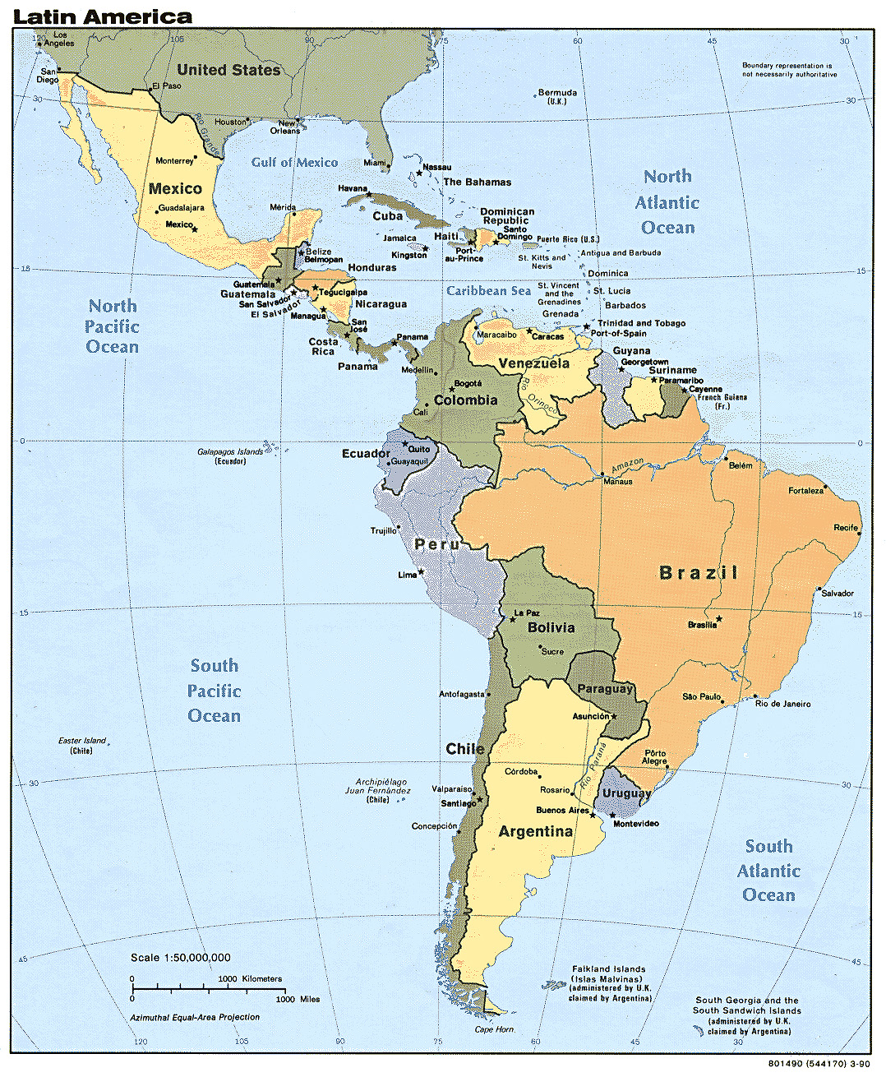
Diversity in Latin America
Cultural, Racial and Geographic Diversity

Slide 16
Modern Political Status
Unity
Instability
Organization of American States (OAS)
Peaceful way of settling disputes
United 35 Independent States
Develop cooperation among West Hemisphere
Power in the hands of few
Civilian governments replaced by military governments and dictators established
1959 Cuban Revolution- Communist government because government not meeting the demands of people (Fidel Castro)
Longest history of stable government= Costa Rica
Instability= economic poverty

Slide 17
Modern Economic Status
Wealth in the hands of few
Land reform= distribution for more equality
Plantations (Mexico: no US immigration= pressure on economy)
Controlled by World Market
Cash Crop dependence
Need to export raw materials (international market demand)
NAFTA
Need for $$
Movement of people into cities for economic improvement (Post WW2)
Political instability= no economic improvement
Lack of money for industrial development
International Debt (Argentina, Brazil and Mexico)

Slide 18
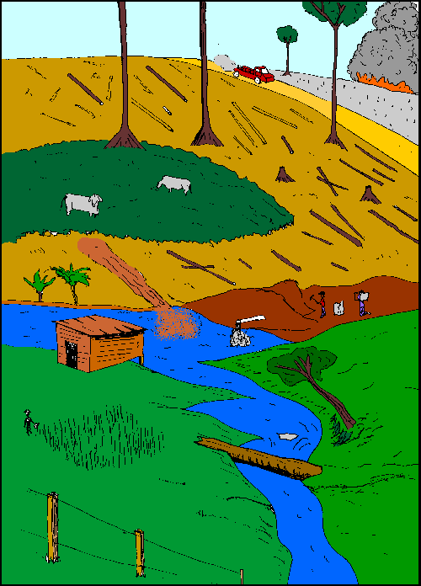
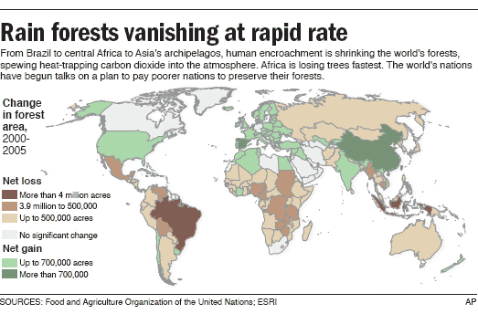
Modern Environmental Status
Deforestation of the Amazon

Slide 19
Modern Social Status
Traditional Middle Class= father runs the family (patriarchy)
Landowners oppose economic and social change
Education= social mobility
Roman Catholic Church= active in social and human rights issues

