Slide 1
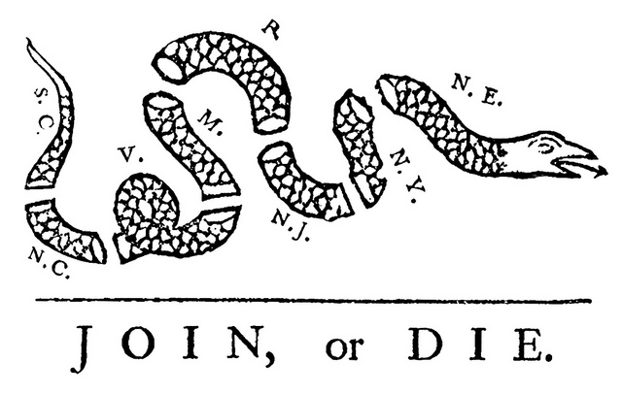
AIM: How did the French and Indian War create more tension between the British and the colonists?

Slide 2
I. French and Indian War
1754-1763 – a war between the British and their American allies (colonists) VS. the French and their Native American allies
French had a good relationship with Native Americans because of the fur trade (French not interested in conquering land)

Slide 3
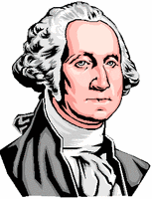
A. George Washington—sent by governor of Virginia to evict the French

Slide 4
1. 1754—militia attacks the French→start of the French and Indian War
B. Ben Franklin proposes Albany plan of Union (worksheet)
1. Wants to unite colonies under central government under British control
2. start of nationalism
3. colonies do not want to give up power despite common interests

Slide 5
The Albany Plan of Union
1. What is Ben Franklin proposing?
2. State two stipulations of the plan in your own words
3. Was it successful? Why/why not?

Slide 6
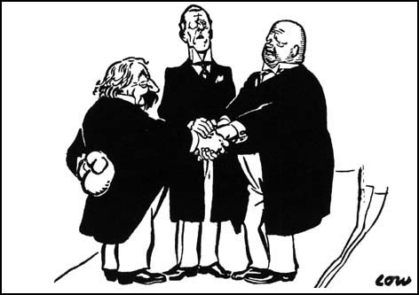
II. Treaty of Paris (1763)
A. End of war
1. land exchange→Britain gains , France loses

Slide 7
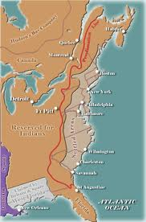
III. Proclamation of 1763

Slide 8
A. Appalachian mountains become dividing line
1. Colonists may not move west
2. Native Americans may not move east
3. Difficult to enforce

