Slide 1
Aim: What was “Reconstruction”?
Do Now:
Imaging that you are President Lincoln and the Civil War has just ended. The Union is victorious! What would be your (3) greatest concerns now that the rebellion is over?

Slide 2
Aim: What was “Reconstruction”?
Reconstruction: (1865-1877)
The period of rebuilding the country after the Civil War

Slide 3
Questions Reconstruction will address:
How would the South, physically damaged by war, and socially changed by emancipation be rebuilt?
How will the Southern states be reintegrated into the Union?
How would the liberated Blacks survive as free men and women?
Who would control the process of reconstruction: The President or Congress?

Slide 4
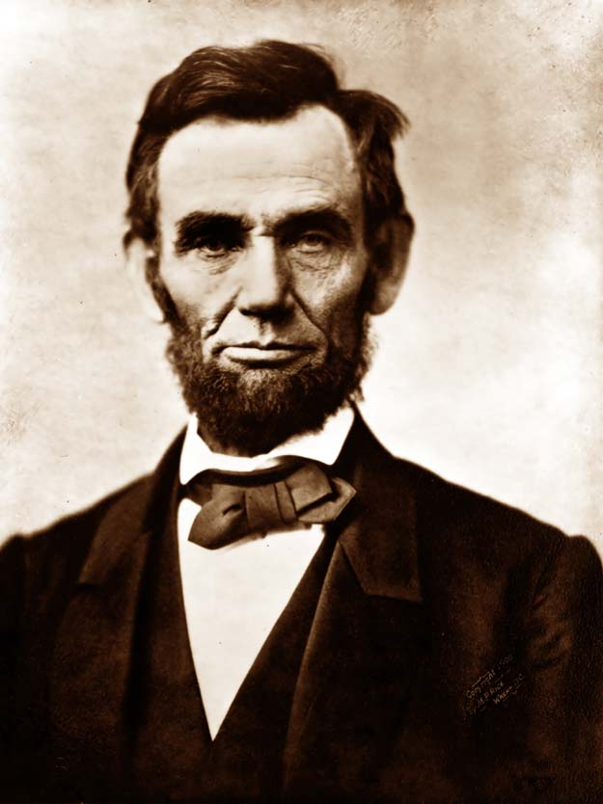
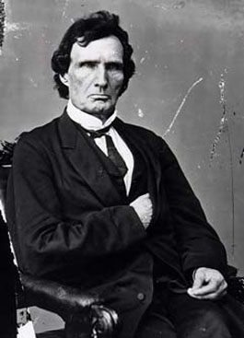
Forces of Reconstruction
President Lincoln
(Republican)
Congressman Thaddeus Stevens
(Radical Republican)

Slide 5
Attitudes on Reconstruction:
“With malice toward none and charity for all…let us strive on to finish the work, we are in, to bind up the nation’s wounds…to do all which may achieve and cherish a just and lasting peace among ourselves and with other nations.”
-President Abraham Lincoln (1864)
“The time has arrived when the American people should understand what crime is, and that it should be punished, and its penalties enforced and inflicted…Treason must be made odious…Traitors must be punished and impoverished…their power must be destroyed.
-Thaddeus Stevens (Radical Republican in Congress, 1865)

Slide 6
Whose authority is reconstruction?
Lincoln: The states never seceded therefore the Constitution states, “the President has the authority to put down rebellions (Chief Executive)
Congress: The states did in fact leave the Union and the Constitution states, “Only Congress has the power to admit new states”
Who do you agree with? Does it matter who is in charge?

Slide 7
How would Southern states be reintegrated into the Union?
Lincoln’s Plan
Congressional Plan (Wade-Davis Bill)
A state could be readmitted if 10% of its voters took a loyalty oath to the United States and pledged to abide by emancipation
A state could be readmitted to the Union if 50% of its voters to an “ironclad” loyalty oath

Slide 8
How should ex-Confederate be treated?
Lincoln’s Plan
Congress’ Plan
Pardons would be granted to ex-Confederates who swore allegiance to the U.S. (Proclamation of Amnesty)
No pardons for Confederates who took up arms against the U.S.

Slide 9
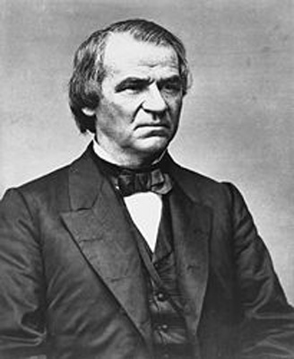
President Andrew Johnson
Democrat
Tennessee
Which plan do you think that he will go for?

Slide 10
Johnson’s Plan
Recognized Lincoln’s 10% plan
Disenfranchised leading Confederates (those with over $20,000 of property)
Forced states to ratify the 13th Amendment (ending slavery) before readmission
Granted pardons to all but highest ranking exConfederates

Slide 11
Did Johnson’s plan change anything in the South?
Many Southern states passed Black Codes-laws designed to keep blacks in virtual slavery

