Slide 1
Aim: How were Women and Children Treated by industrialists?
Do Now: Fill in the blank to the following equation:
The U.S. was ripe for prosperity.
Technology + Financial banking + ________ = Industrialization
WORKFORCE

Slide 2
The Growing Workforce
Contract of Labor Act 1864—
encouraged immigration throughout America.
Industries and businesses offered contracts to immigrants shortly after the Civil War.
contracts gave immigrants free entrance to America, if the immigrants promised to work for the industries

Slide 3
Working Families
Every family member worked—Why?
Low wages; no 1 person could support the household
Children at 12-13 yrs. old would leave school to work; more often girls than boys
If a mom couldn’t make money at home, she’d work in a factory
**No gov’t assistance at this time

Slide 4
Social Darwinism
It appealed to people
People were poor because they were weak
Offering help would encourage idleness
Supported Laisse Faire Capitalism

Slide 5
Factory Work
10 hr. work day rarely enforced
Most laborers worked 12 hr./day 6 days/week and had to meet production Could reach 19 HOURS!
Payed not by hourly wage but by piecework: payed by how much you produce
Workers were a slave to the clock
Division of labor—no longer from start to finish like Craftsmen
How were workers treated?
(Far and Away)

Slide 6
Working Conditions
Deafening noise from machines
Poor lighting, ventilation & heat
Average number of workers killed on the job each week in 1882→ 675.
Why would people work there??
Factories offered higher pay & more opportunities than other places
Very Dangerous
Working Conditions

Slide 7
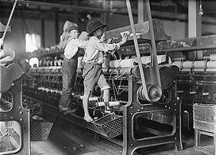
Working Women and Children
1880 made up 5% of the workforce
Often whipped in a whipping room
Working children = food on the table

Slide 9
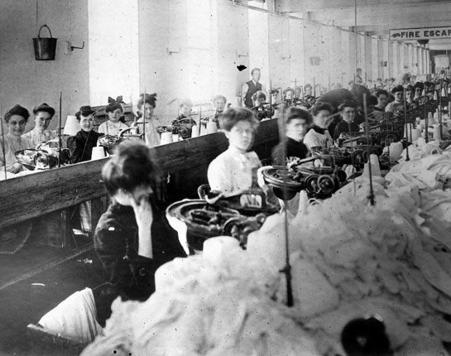
Working Women and Children
Women
Employers excluded women from high paying jobs & most skilled jobs
Thought they’d be better at “women’s work”
Only men had access to training on more complicated machines
Advancement?
Women had NO opportunity
Employers assumed they were being supported by a man’s salary

