Slide 1
AIM: Is the One Child Policy a necessary method to control the population in China?
http://www.cnn.com/2015/03/30/asia/china-one-child-policy-undo/

Slide 2
Do Now:
“We would rather shed rivers of blood than have one extra child!”
“Induce or abort, but not bear!”
--What do these slogans have in common?
--Describe how you would feel if you saw these statements displayed in public?

Slide 3
One Child Policy
“family planning policy”
“Of all things in the world, people are most precious.” –Mao Zedong
Implemented in 1979 (Deng Xiaoping) for population control in China
Strictly enforced in urban areas of China

Slide 4
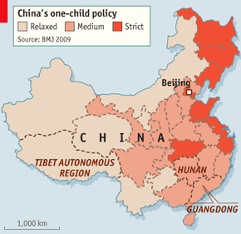
http://www.economist.com/node/18988926

Slide 5
How is it enforced?
Incentives: “Certificate of Honor for Single-Child Parents” (more access to government assistance, higher salaries….)
Penalties: financial burdens, seizing of property, loss of jobs
(penalties vary by region and situation)

Slide 6
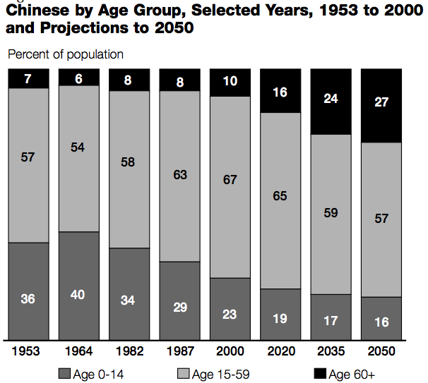
Is the One Child Policy good for the demographics of China?

Slide 7
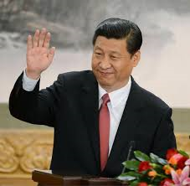
Xi Jinping
-President of China-March 2013
-Dissolved National Population and Family Planning Commission (Merged with National Health and Family Planning Commission)

Slide 8
Let’s look at some evidence:
You have been chosen to work on the National Health and Family Commission. Propose to the committee whether or not it would be a good idea to formally abolish the One-Child policy throughout all areas in China. Be able to justify your position of the issue.
http://apecsec.org/china-one-child-policy-pros-and-cons/

Slide 9
Universal Declaration of Human Rights
Article 16
1. Men and women of full age, without any limitation due to race, nationality or religion, have the right to marry and to found a family . They are entitled to equal rights as to marriage, during marriage and at its dissolution.
2. Marriage shall be entered into only with the free and full consent of the intending spouses.
3. The family is the natural and fundamental group unit of society and is entitled to protection by society and the State.
Article 17
1. Everyone has the right to own property alone as well as in association with others.
2. No one shall be arbitrarily deprived of his property.

