Slide 1
Korea The Cultural Land Bridge of Asia

Slide 2
Geography of Korea
Peninsula
5,400 miles of coastline
70% of land covered by low mountains
Terrace Farming
Population concentrated along western plains
People of Korea farmed and fished
Location= Invasion

Slide 3
Korea’s Nicknames
“land of the morning calm”
Surrounded by water (peninsula)
“the Hermit Kingdom”
Westerners began to call Korea this after the Choson (Yi) Dynasty closed itself off from foreign contact
The word “hermit” means isolated

Slide 4
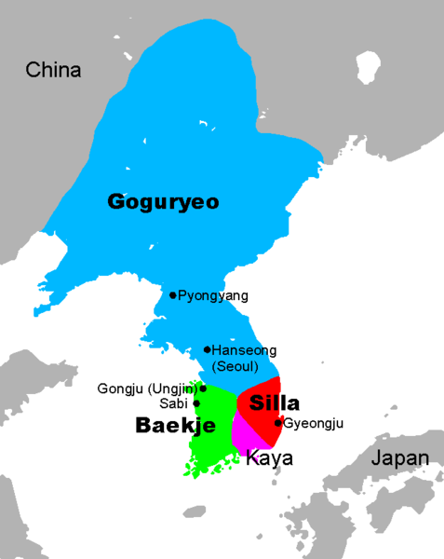
HISTORY of KOREA
300 – 600 AD (or C.E.)
KOREA was divided into THREE KINGDOMS
KOGURYO, PAEKCHE, SILLA
UNDER THE SILLA, KOREA BECAME A TRIBUTARY STATE OF CHINA

Slide 5
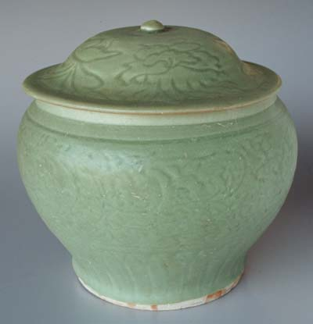
HISTORY of KOREA
918-139 KORYO DYNASTY
BUDDHISM REACHED ITS GREATEST INFLUENCE (nature)
CELADON PORCELAIN
Military revolt and rule, peasant uprisings (1100’s)
1392-1910 CHOSON or YI DYNASTY
HANGUL
DEVELOPED IN 1443 BY CHOSON KING SEJONG
WRITING BASED ON CHINESE BUT UNIQUE
INCREASED LITERACY RATE

Slide 6
INFLUENCES FROM CHINA {Colonial Expansionism during Confederate Kingdoms (400 BC- 108 AD)}
BUDDHISM
Coexistence with Confucianism
CONFUCIANISM
FILIAL PIETY
CIVIL SERVICE EXAMINATIONS
BUT ONLY ARISTOCRATS COULD TAKE THE EXAM

Slide 7
Influence from Japan
1895 Japan had defeated China
1910 Japan took over Korea
Japanese refused to learn Korean, instead, Koreans were forced to learn Japanese
Newspapers were published in Japanese
Korean was prohibited throughout the country
Japan controlled Korea until 1945

Slide 8
World War II Divides Korea
1945: Japan was defeated
U.S. and Soviet Union divided Korea at an area called the 38th parallel
Each nation had set up governments and in the South free elections were held

Slide 9
The Korean War
After 1945 the Cold War took place
U.S. vs. Soviet Union
Democracy vs. Communism
1950 – 1953 : The Korean War
Called “the forgotten war”
Ended with an armistice (truce) which still exists today

