Slide 1
HOW DID INDIA’S GEOGRAPHY HELP ITS CIVILIZATIONS DEVELOP?

Slide 2
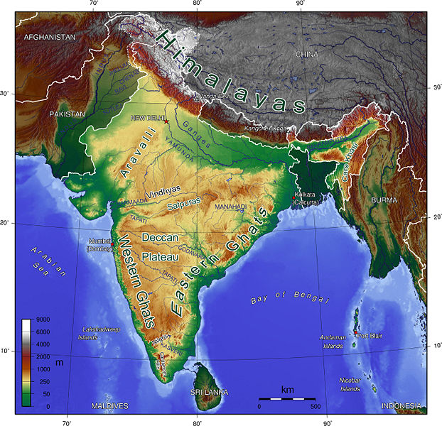
Geography of India
India considered a sub-continent
Geographical Diversity= Cultural Diversity

Slide 3
Diverse Geography
NORTHERN BORDER= MOUNTAINS
  Himalayas
  Hindu Kush
  Khyber Pass= Invasion
NORTHERN PLAIN = FERTILE, CLOSE TO RIVERS (Ganges River= Sacred)
  Where India’s 1st Civilization Began
DECCAN PLATEAU = DRY, NOT MANY PEOPLE
  Very few people, not good for farming
COASTAL PLAINS = FLAT, CLOSE TO OCEAN
  On East and West Coast
  Farming, Fishing and Trading
  Monsoons (West Coast)= Seasonal Winds
Isolation

Slide 4
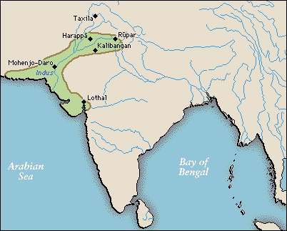
Indus River Valley
Why settle on rivers????

Slide 5
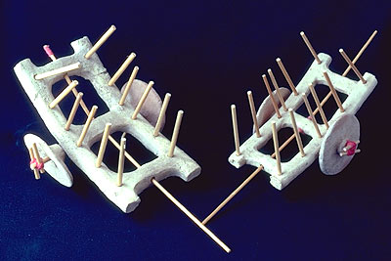
Indus River Valley
Major cities: Harappa and Mohenjo-Daro
Peaceful civilizations: toys, few weapons found
City Planning
Uniform housing suggested classless system

Slide 6
INVADERS!
1500 BCE Aryan invaders get in through the Khyber Pass
Caste system and Hinduism introduced
- Social class system
Political system
- Component of Religion
RELIGION

Slide 7
Hinduism
POLYTHEISTIC
  MANY GODS (HUNDREDS)
HOLY BOOK: VEDAS
HOLY RIVER: GANGES
HOLY ANIMAL: COW
THREE MAJOR GODS:
  Brahma
  Shiva
  Vishnu
Rigid class system: Caste system
Major Beliefs
Follow Your DHARMA
Have Good KARMA
Reach MOKSHA
Belief in REINCARNATION
  Soul keeps returning

Slide 8
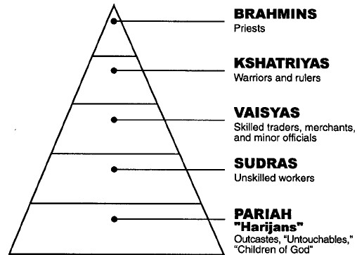
Caste System
Components
  Established at birth
  Supported by ideas of dharma and karma (Hinduism)
  Sense of Identity- friends, occupation
  Established rules for society: Rigid (colonial Latin America, Feudal System)
Impact on Life
  Limited Social Mobility and Economic Progress
Weakened by Urbanization (movement to cities)
= Aryan
= Non- Aryan

Slide 9
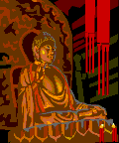

Buddhism
FOUNDED IN INDIA (400 BCE)
FOUNDER WAS SIDDHARTHA GAUTAMA
  PRINCE OF THE WARRIOR CASTE
  HAD NEVER SEEN THE SORROWS OF THE WORLD

Slide 10
Major Beliefs of Buddhism
FOUR NOBLE TRUTHS
  ALL LIFE IS SUFFERING
  THE CAUSE OF SUFFERING IS DESIRE
  OVERCOME SUFFERING BY ENDING DESIRE
  OVERCOME DESIRE BY FOLLOWING THE EIGHTFOLD PATH
EIGHTFOLD PATH
  RIGHT WAYS OF LIVING
REINCARNATION
TWO KINDS OF BUDDHISM
  THERAVADA (elders)
  MAHAYANA (yoga)
HOLY BOOK: TRIPTIKATA
GOAL: NIRVANA

Slide 11
Great Empires of India
Maurya and Gupta
MAURYAN EMPIRE (260 B.C.)
  Leaders united the sub-continent
    Had a well-organized government: bureaucratic system
  Contributions: schools, libraries and spread of Buddhism

Slide 12
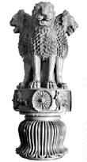
Leader of the Mauryan Dynasty
(321 to 185 B.C.)
Chandragupta was the first great leader
  Organized and united his land
  Kept law and order with strict justice
Asoka was the grandson of Chandragupta
  Great warrior turned BUDDHIST
  Put up stone pillars to remind people of Buddhist ideas

Slide 13
The Gupta Dynasty
(500- 700 AD)
Like the Maurya united India
Influence of Hinduism on everyday life
Considered India’s GOLDEN AGE
  Math: ZERO
  Science: SURGERY/VACCINES
  Architecture: STUPAS (temple complexes)
  Writing System: SANSKRIT

Slide 14
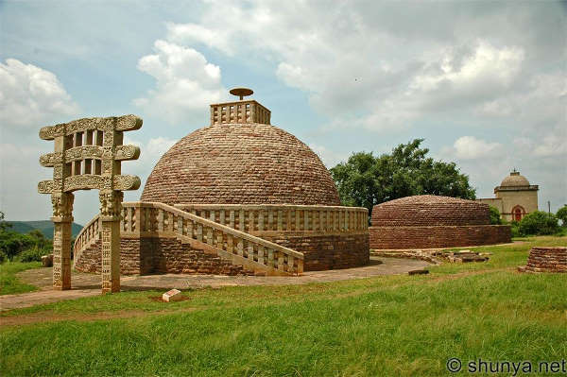
STUPA

Slide 15
Islam (Muslims) in India
Fall of the Gupta broke India into small rival kingdoms
Muslim Turks came into Indus and took over creating the Delhi Sultanate and spread Islam
By 1400 the Mughals who claimed to be descended from Genghis Khan took over
16th century ruler AKBAR is the most famous Mughal ruler: TOLERANT and FAIR

Slide 16
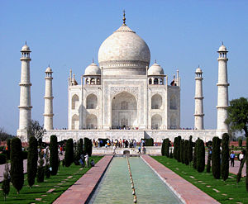
Mughal Empire and Imperialism
17th century Shah Jahan created the Taj Mahal
The cost of the building led to famine and trouble for the empire
The British gained economic control over India at this time and eventually political control

Slide 17
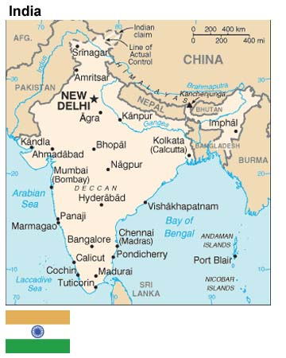
Modern India
From Colony to Independent country

Slide 18

British in India
The British began trade with India during the Mughal Empire
The British East India Company sets up exclusive trading rights
British dominate India:
  “the sun never sets on the British Empire”

Slide 19
Sepoy Mutiny
Rebellion
SEPOYS = Indian troops employed by British
1857 – Sepoy Rebellion (aka Sepoy Mutiny)
  British greased the cartridges with pork or beef fat
  MUSLIMS don’t eat pork
  HINDUS don’t eat beef
  Sepoys rebelled against the British
  Ended violently with many on both sides killed
  1858 BRITISH GOVERNMENT officially takes over (lack of unity in India- geography)

Slide 20
British Control of India
NEGATIVE EFFECTS
  100 year presence in India
  Small industries could not compete with British industry
  Loss of tradition
POSITIVE EFFECTS
  British built railroads, dams, bridges, and roads (allowed for greater British control)
  Started schools and colleges
  Parliamentary Government

Slide 21
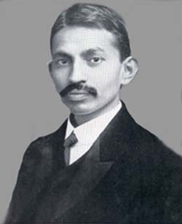
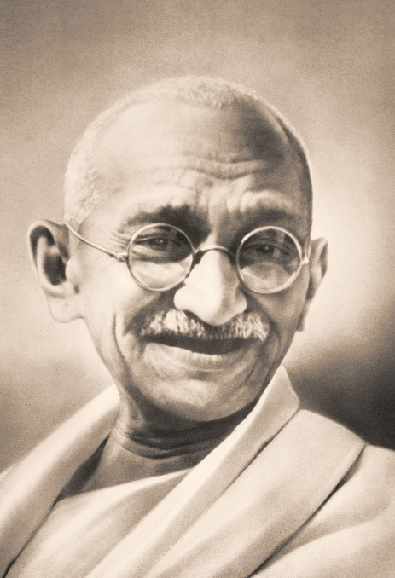
Mohandas Gandhi
Born in 1869
Studied law in England
Practiced law in South Africa
Returned to India by 1915 and became active in the INC – Indian National Congress (1885- 1947)
NON-VIOLENT PROTEST to end British rule (civil disobedience)

Slide 22
From Mohandas to MAHATMA
Mahatma = great soul
Against the discriminating caste system
BOYCOTTS of British goods were encouraged
STRIKES and DEMONSTRATIONS became the weapon of the Gandhi and his followers
1930: SALT MARCH as a protest to the salt tax
  240 mile walk led by Gandhi to the western coast of India

Slide 23
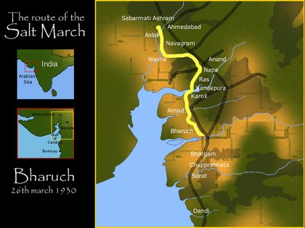
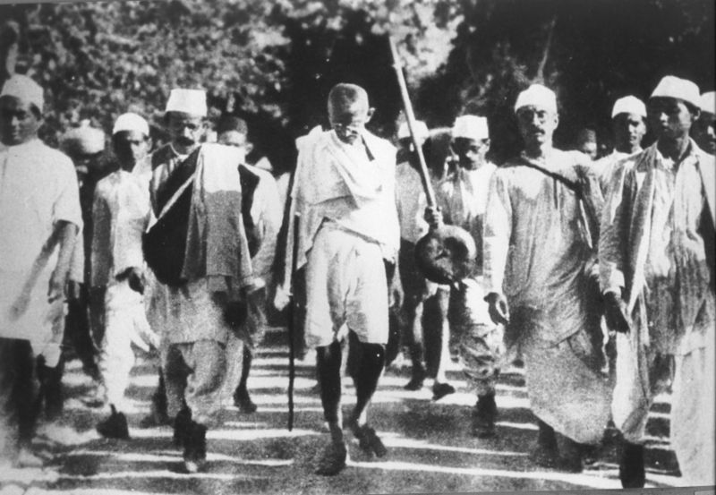
The Salt March

Slide 24
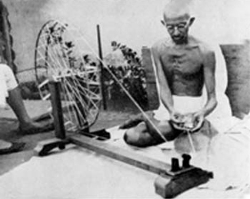
The Homespun Movement

Slide 25
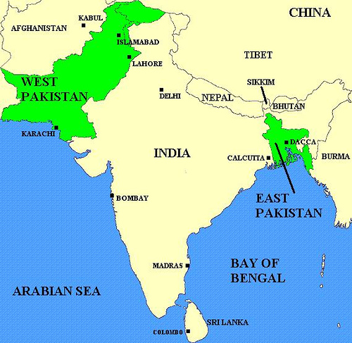
Independence
By 1947 after all of Gandhi’s efforts, India is free of British rule
NEW PROBLEM:
  Indian National Congress = HINDU
  Muslim League = MUSLIM
  The Muslim League is worried that if the INC has control of Indian politics, they will not be well represented

Slide 26


Nehru and Jinnah
JAWAHARAL NEHRU
-1947: became first president of an independent INDIA
-- Border disputes with Pakistan and China (1950’s)
-proponent of the Green Revolution (1960’s- 1970’s)
-practiced policy of non-alignment (Cold War)
MUHAMMAD ALI JINNAH
-became first president of PAKISTAN
-East and West Pakistan separate because of cultural and economic differences

Slide 27
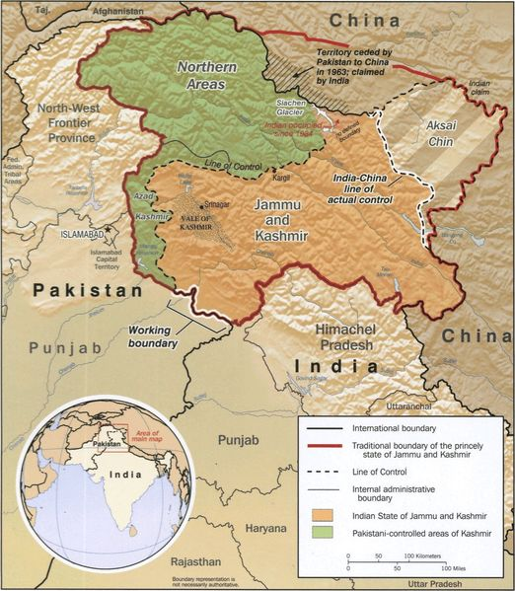
India 1980’s to Today
After 1947 India developed mixed economy
  Command + Market
Slow democratic development
Urbanization
  Decrease traditional values
  Changed role of women
  Disconnect between law and tradition
Population = over 1 billion mostly in fertile north (1980’s limit population quality of life)
INDIA has no oil or natural gas
Government run industries are ineffective (need for more foreign investment although in the 1980’s)
India continues to fight with Pakistan over the region of KASHMIR (cultural and religious differences, terrorism)

