Slide 1
Europe Part One
Middle Ages to the Enlightenment

Slide 2
Greece
Geography (mountains & islands)= hard to unify
Polis= city-state
ATHENS | SPARTA
Direct Democracy (Pericles) Individual was important Woman did not have many rights Art, literature, theatre important to people | Oligarchy with King Individual served the state Women had many rights Militaristic society

Slide 3
Greece: Conflicts, Defeats and Victories
Persian Wars (490- 479BC)
Persia vs. Greece
ALL city-states unite to conquer enemy
GREECE WINS!!!
Peloponnesian Wars (431- 404BC)
Athens vs. Sparta
Sparta forms alliance with Persians
SPARTANS WIN!!!!
Alexander the Great
4th century BC Philip of Macedonia (father) unites Greece
Taught by Aristotle
Empire extended from Greek to India
Blended cultures he conquered: HELLENISTIC CULTURE
Persian, Indian, Greek, Egyptian

Slide 4
Legacy of Greece
Golden Age
Art (classical sculpture)
Architecture (columns, pediments, theatres)
Philosophy
Lover of wisdom
Socrates, Plato, Aristotle
Democracy
Citizens participate in government

Slide 5
Roman Republic
Broad Plains= easy to unify
Society
Patricians= Landowning Nobility (rights and government)
Plebeians= merchants, farmers and artisans (had to fight for rights)
Republic= thing of the people
Government
Two Consuls- Both Patricians
Senate= 300 PATRICIAN members
Law
Twelve Tables- displayed in forum, criminal and civil laws
Decline
Civil War after death of Julius Caesar

Slide 6
Roman Empire (Pax Romana= Peace)
Octavian Augustus= 1st Emperor of Rome
Maintained some of Republic’s ideas
Created civil service
Kept the Senate working
Let plebeians work in government
Fall of Rome
Political- corruption and power hungry leaders
Social- gap between rich and poor
Economic- high taxes
Military- mercenaries lack loyalty

Slide 7
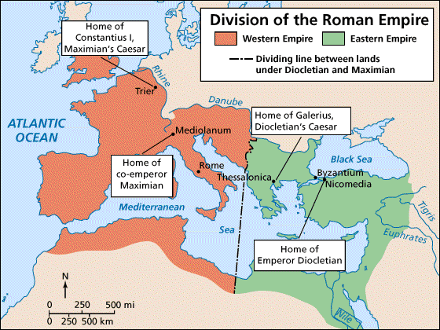
Rome Divides
Eastern Rome- Byzantine Empire (306-1453)
Location= Trade, Crusades- Cultural Diffusion
Eastern Orthodox Church= No Icons
Constantinople
Preservation of Rome and Greek culture (ex. Justinian Code)

Slide 8
The Early Middle Ages (Western Roman Empire- 5th to 10thcenturies)
Charlemagne (768- 814 AD)
Frankish leader
United more of Western Europe
Made Christianity official religion of Kingdom
Valued Education
Death= failure
Treaty of Verdun (divide kingdom into 3 pieces/ fails, No Central Government

Slide 9
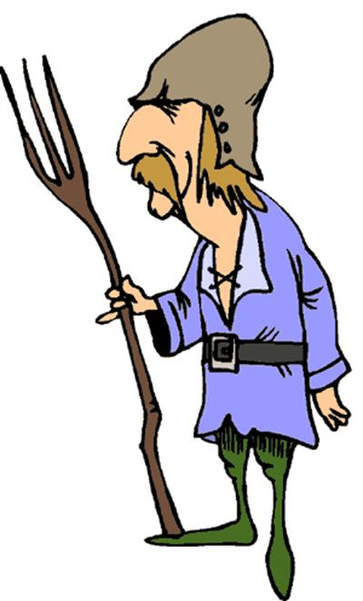
The Middle Ages (1000 AD)
Feudalism (political)
Land received for military service and obligations
Land=power
Church= power and stability
Central governments weak and decentralized
Feudalism= stability

Slide 10
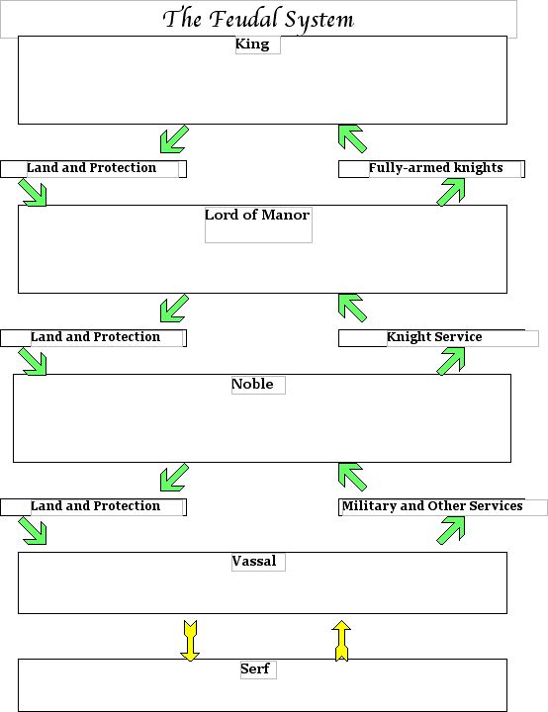
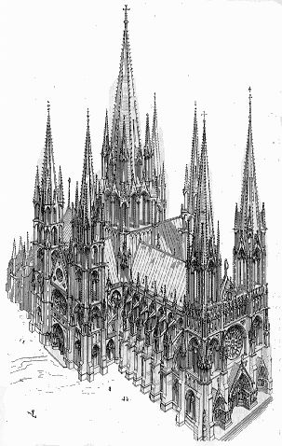
The Middle Ages (1000 AD)
Feudalism (social)
Rigid social class structure
Military (knights/chivalry)= high status
Art=Gothic

Slide 11
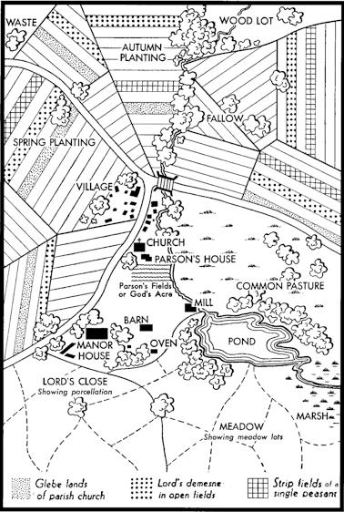
The Middle Ages (1000 AD)
Manorialism (economic)
Centered around the manor
Self- sufficiency
Focus on agriculture

Slide 12
The Crusades (1st Crusade 1095 AD)
Holy War- called by Pope Urban II against Seljuk Turks in the “Holy Land”
Results
Increased trade between Middle East and Europe
Stimulated demands for goods from the East
Cultural Diffusion
Decline of Feudalism
Revival in learning

Slide 13
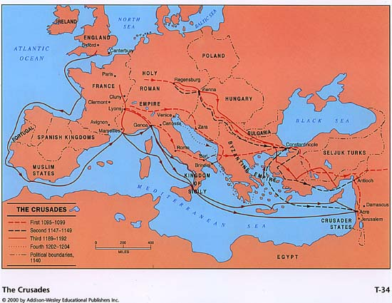
The Crusades

Slide 14
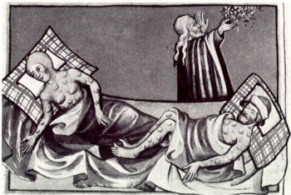
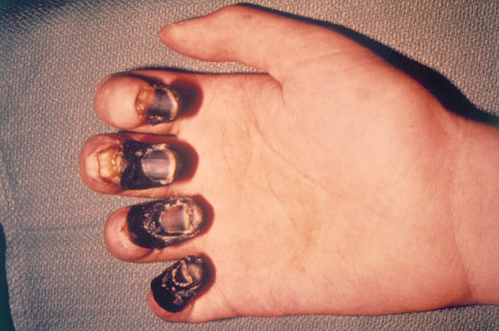
Bubonic Plague/ Black Death (1350 AD)
Results
Killed 30-60% of European population
Eastern Europe least affected
Brought over through trade
Led to questioning and a break down in social order

Slide 15
Renaissance (Begins in the 1300’s AD)
Definition- rebirth in learning
Humanism: focus on human potential and the individual
Perfection- Greece and Rome
Impact
Intellectual, worldly and artistic creativity
Life-like art
Increase in art= wealthy middle class because of increased trade with the Middle East (Begins in Italy)

Slide 16
The Protestant Reformation (1517)
Martin Luther
Renaissance leads Reformation
95 Theses
Indulgences
Catholic Church has no tolerance
Church only concerned with power and riches
Support from King and Princes (dislike of Church power)
Council of Worms
Results
Decrease in religious unity
Decrease in Church power
Increase in denominations
Calvinism (predestination)
Anglicanism
Printing Press- spread of literacy
Counter Reformation- church tries to fix itself
Increase in the power of Monarchies
Origins
Effects

Slide 17
Age of Absolutism (1600’s and 1700’s)
What is Absolutism?
Total power in the hands of a monarchy (centralized power)
Divine Right (similar to Mandate of Heaven)
No consent from the people
Why Absolutism?
Crusades and wars killed feudal lords
Middle class merchants support monarchy if he/she provides protection
Gunpowder= can exert control
Reformation weakened the Church
Nationalism= monarch symbol of unity

Slide 18
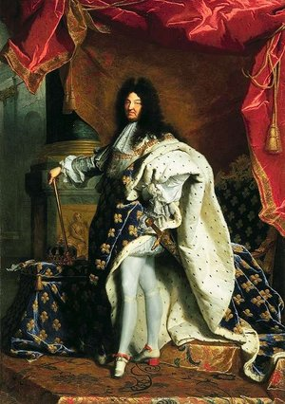
Age of Absolutism (1600’s and 1700’s)
Who was an Absolutist?
Philip II (Spain)
Henry VIII (England)
Louis XIV (France)
Peter the Great and Catherine the Great (Russia)
Westernization
Hobbes and Machiavelli (end justifies the means/ do anything!)

Slide 19
Age of Exploration and Commercial Revolution (Begins 1415)
Why?
Get rid of Middle Man- Middle East
How?
Advances in technology
Map making
Henry the Navigator (Portugal)
Who?
Spain, Portugal, Britain
No Italy or Germany because of lack of unity

Slide 20
Age of Exploration and Commercial Revolution (Begins 1415)
Results:
Mercantilism
Favorable trade- everything benefits the mother country
Raw materials come from colonies
Supports colonialism and imperialism
Exchange of goods, idea and disease
Cultural Diffusion
Columbian Exchange
European Influence in Western Hemisphere
British legal system in America
Commercial Revolution
Credit, guilds, banks WORLD TRADE!!
Conflict
Tension between Colonial powers

Slide 21
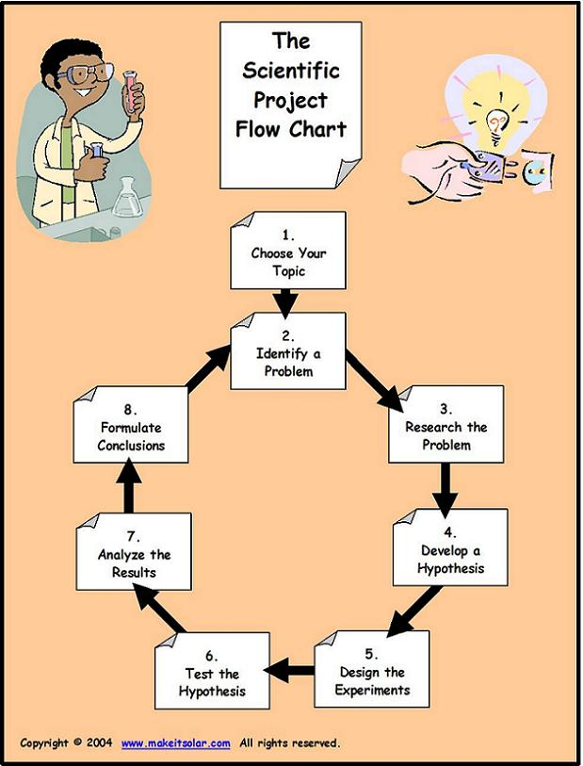
Scientific Revolution (Mid 1500’s)
Question and Examine natural laws of the Universe (inductive reasoning, scientific method)
Bacon, Galileo, Newton, Kepler, Descartes

Slide 22
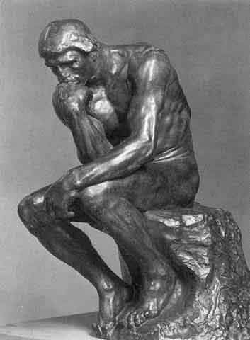
The Enlightenment (1700’s)
Influenced by the Scientific Revolution
Enlightenment= Reason
People:
Locke- freedom and rights of man, natural rights
Hobbes- evil, control
Rousseau- social contract
Montesquieu- three branches of government
Enlightened Despots- Maria Theresa (Austria), Frederick II (Prussia), Henry Iv (France), Emperor Meiji (Japan)
Focus:
Government needs to protect the people
Decisions should be based on the laws of nature and reason
Individual achievement and dignity are important
Encouraged the spread of new ideas
Political Reform (result: sparked the American and French Revolutions)
Social Darwinism??

Slide 23
The Perfect Government/ Economy?
Freedom!!!
Economy
Laissez-Faire- little government involvement
Market Economy- Supply and Demand
Own efforts= gains and loses
Government Control
Economy
Karl Marx/ Engels
Gov’t runs economy
History is a struggle between social classes
Industrialization= peasant revolution
Overthrow Capitalism
Reject western technology and values
Command Economy
Democracy/ Capitalism
Socialism/ Communism

Slide 24
England A Case Study of Democracy
1215- Magna Carta
1628- Petition of Right
1688- Glorious Revolution-James II “out” William of Orange “in”
1689- Bill of Rights
RESULT
LIMITED THE MONARCHY, CONSTITUTIONAL MONARCHY

