Slide 1
China
Early and Modern China Regents Review

Slide 2
Geography of China
North : GOBI DESERT
West: TAKLIMAKAN DESERT
East: YELLOW SEA
  Close to Japan and Korea= Influence
South: HIMALAYA MOUNTAINS
  PROTECT and ISOLATE
RIVERS: Yangtze and Huang He (Yellow)
  Huang He = River of Sorrows
    Historical significance: evidence of NEOLITHIC civilizations found at Huang He
    Loess = fine yellow soil gives the river its color
    When the loess settles – the river overflows

Slide 3
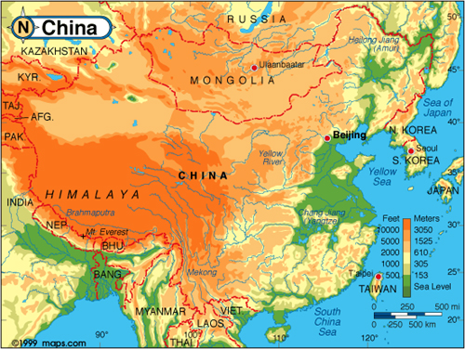
Geography of China
Scarce Arable (Farmable) Land
  High production of Rice and Grain
  Irrigation Systems
  Innovative Farming

Slide 4
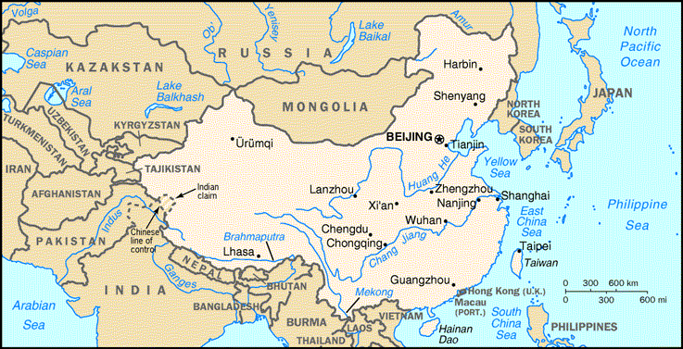

Slide 5
Early Culture
(Traditional Early China)
Due to Geographic Isolation= rejection of other cultures (ethnocentric)
Communication/Spread of Culture
  Written Form
  Family is Central
    Early History- learn traditions through family
    Learn Social Change through family

Slide 6
EARLY RELIGION
NATURE
  Many gods that related to the natural world around them
ANCESTOR WORSHIP
  Those who had passed on before watched over you
YIN and YANG
  Balance between:
    MALE and FEMALE
    DARK and LIGHT

Slide 7
CHINESE SCHOOLS OF THOUGHT: CONFUCIUS = Kong Fuzi
Born in the 6th century BC
PEACE AND HARMONY
  Moral Conduct
  Importance of Culture
Famous for his ANALECTS
  Writings that were based on Confucius’ sayings
FIVE RELATIONSHIPS
  Father to son, elder brother to younger brother, husband to wife, ruler to subject, friend to friend
  Responsibility to family and society

Slide 8
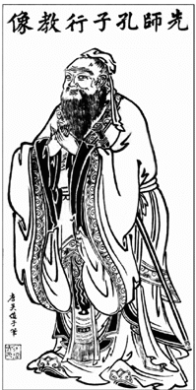
CONFUCIANISM
FILIAL PIETY
  This was the most important of a person’s duties according to Confucius
  RESPECT FOR PARENTS
INFLUENCE:
  GOVERNMENT rulers must be JUST and rule by Example
  EDUCATION is needed to ADVANCE in society

Slide 9

DAOISM or TAOISM
Founded by LAOZI
3rd or 4th century BC
DAO = the way
LIVE IN HARMONY WITH NATURE

Slide 10
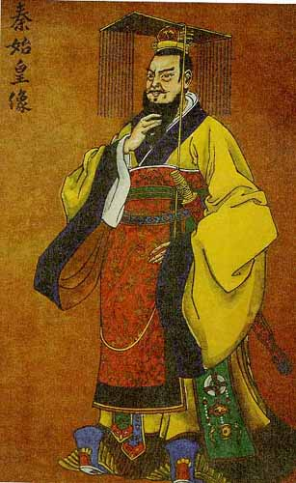
LEGALISM
Founded by HANFEIZI in the 3rd century BC
Men were naturally evil
Rulers should have complete power
Used by the QIN DYNASTY by Emperor SHI HUANG DI

Slide 11
Early Politics
Dynastic Cycle
  Weakness of Central Government= Rise of Warlords
Mandate of Heaven= Divine Right (Europe)
A new ruler unites China and gains the Mandate of Heaven.
Under the new dynasty prosperity.
The population increases.
Corruption becomes rampant in the imperial court, and the empire begins to enter decline and instability.
A natural disaster wipes out farm land. The disaster normally would not have been a problem; however, together with the corruption and overpopulation it causes famine.
6. The famine causes the population to rebel and a civil war ensues.
Ruler loses the Mandate of Heaven.
8. Population decreases- violence.
9. Goes through a warring states period.
10. One state emerges victorious.
11. The state starts a new empire.
12. The empire gains the Mandate of Heaven

Slide 12
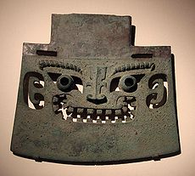
EARLY PEOPLE OF CHINA
Nomadic at first
Settled near rivers
Earliest civilization:
  SHANG DYNASTY 1650 – 1027 B.C.

Slide 13
SHANG CIVILIZATION
KINGS
  DYNASTIC RULE
Noble Warriors
  Owned land
Artisans
  Made goods
Merchants
  Sold goods
Peasants
  Worked the land

Slide 14
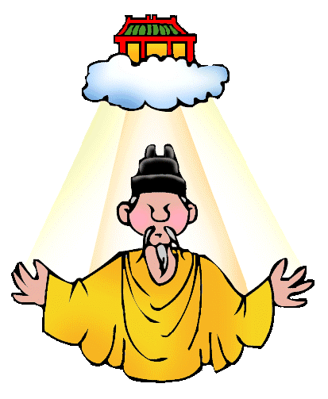
DYNASTIC RULE IN ANCIENT CHINA
Shang Dynasty (1650-1054BC)
  Early writing
  Practiced human sacrifice
  Prayed to nature and ancestors
Zhou Dynasty (1054-221 BC)
  Controlled most of China after the Shang
  Sacrificed statues not humans
  Also prayed to nature and ancestors
  Development of idea of the Mandate of Heaven
    Mandate = permission

Slide 15
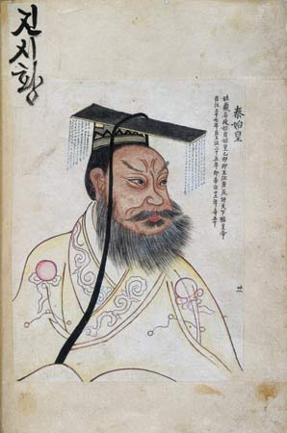
QIN DYNASTY
Qin Dynasty (221-206 BC)
  Begins with Shi Huang Di
  Unified China
  Strict Legalism
  Punishments for crimes were severe and often deadly
  Started GREAT WALL
  Tomb of Shi Huang Di
  BURNED BOOKS

Slide 16
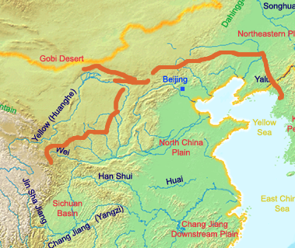
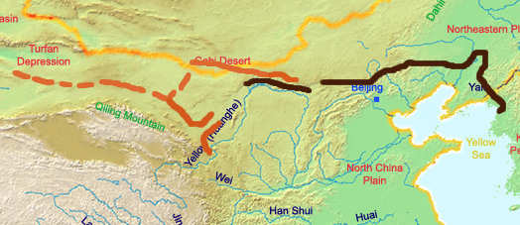
GREAT WALL OF CHINA
QIN and HAN

Slide 17
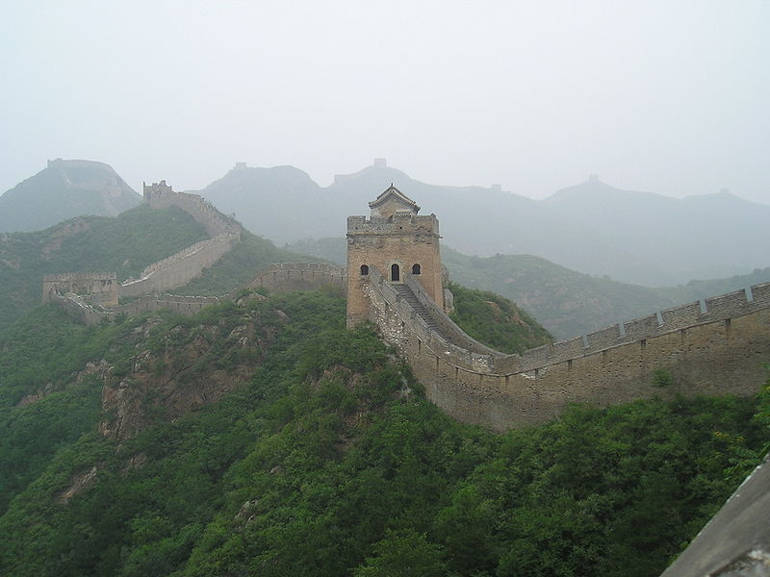
GREAT WALL OF CHINA

Slide 18
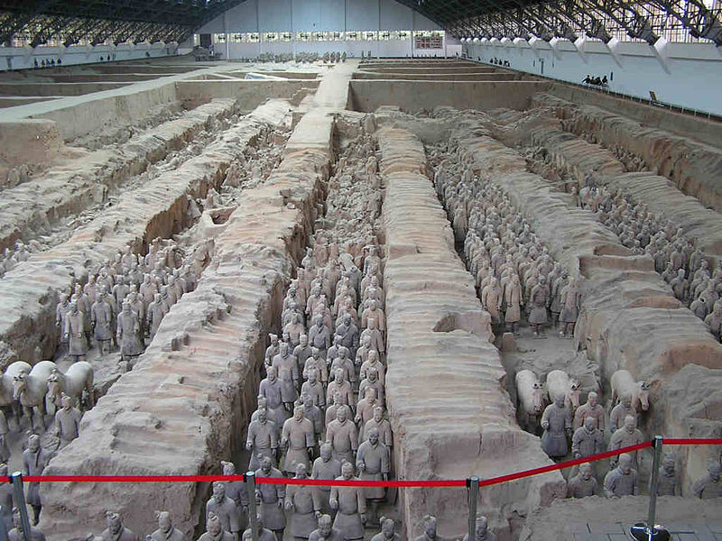
TOMB OF SHI HUANG DI

Slide 19
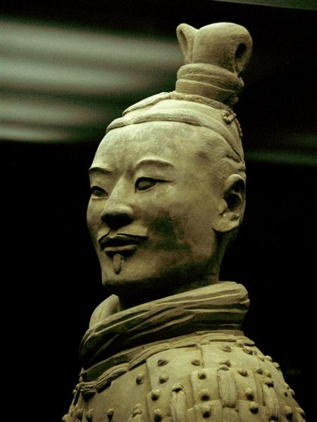
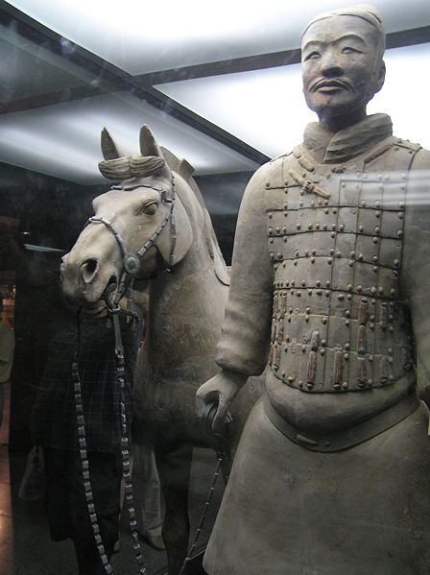
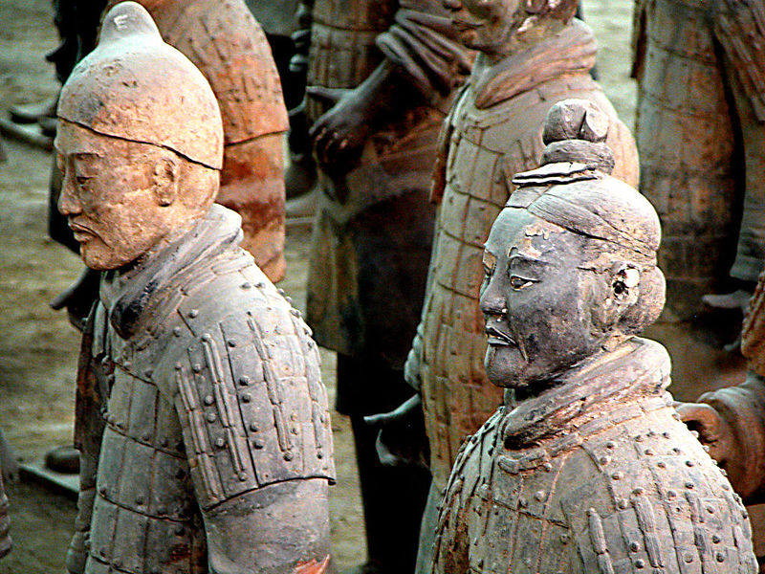
TERRACOTTA ARMY OF SHI HUANG DI

Slide 20
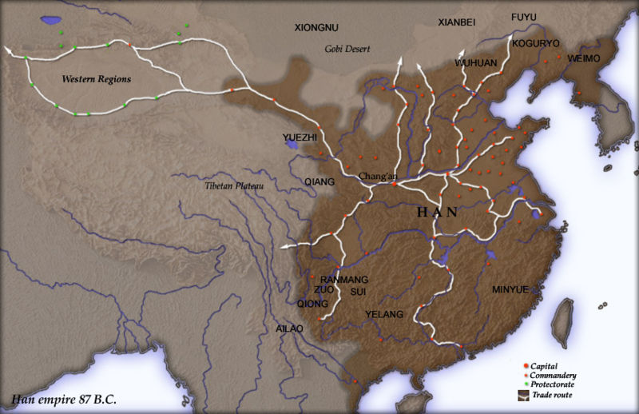
Fall of the QIN rise of the HAN
Civil war followed Qin dynasty’s end
Liu Bang was first emperor of the HAN dynasty
200 B.C. – A.D. 220 the HAN ruled China

Slide 21
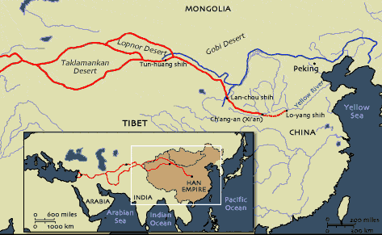
Han Dynasty
Han Dynasty (206 BC-220 AD)
  Eliminated strict policies of Shi Huang Di
  Civil service examination allowed people to work in government
  Established SILK ROAD= communication
    Silk Road- exchange of goods and culture (Buddhism); Cultural Diffusion

Slide 22
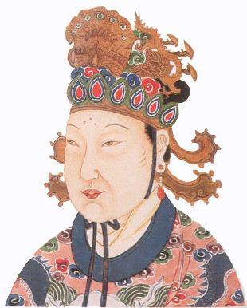
TANG DYNASTY
GOLDEN AGE
EMPRESS WU ZHAO created a bureaucracy, and organized the government
Land reform gave peasants land
Transportation & trade increased
Corruption in government, high taxes and natural disasters
TANG DYNASTY (618-907 AD)
  Followed Confucianism
  Civil Service Exams
  Made neighboring countries tributary states
  Gunpowder, block printing, smallpox vaccine

Slide 23
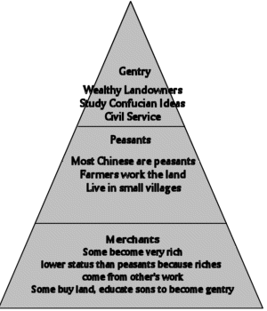
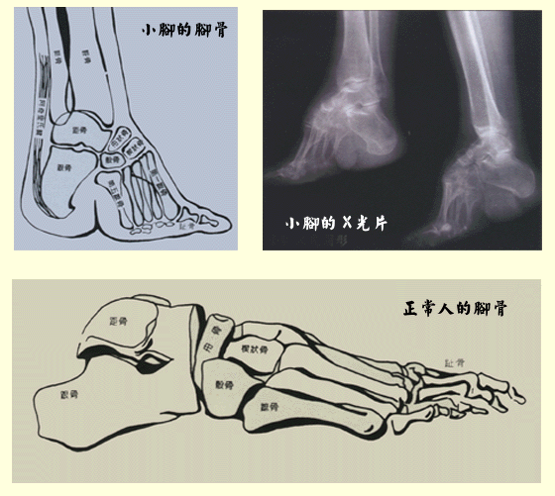
SONG DYNASTY
UNITED by ZHAO KUANGYIN a general
Controlled less land than the TANG
Surplus led to wealth which allowed people to make ART!- GOLDEN AGE
FOOTBINDING also became popular
SONG DYNASTY (907-1215 AD)
  Followed Confucianism
  Land reform
  Expansion of trade
  Strict social order
  Developed moveable type

Slide 24
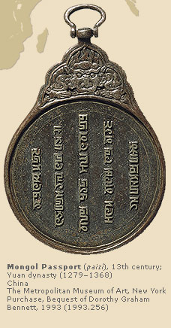
THE MONGOLS
13th century Mongols invaded China
KUBLAI KHAN (grandson of Genghis Khan) became the next ruler of China
Adopted the name YUAN DYNASTY (1279- 1368)
1254: Marco Polo
  sent on government missions throughout China

Slide 25
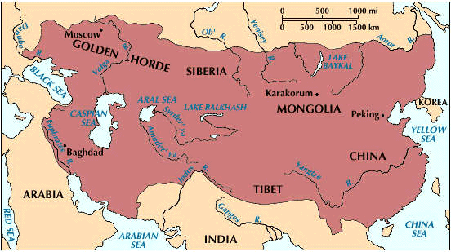
MONGOL EMPIRE

Slide 26
End of the YUAN
At its height, Yuan Dynasty controlled an area FOUR times larger than the Roman Empire
  Superior Military led to expansion
  Increased trade and travel
Under Kublai Khan, Mongols and the Chinese were divided by occupation and social status
After Kublai Khan’s death - the Yuan declined
1368: MING DYNASTY takes over
MING = BRILLIANT

Slide 27

MING DYNASTY AND ZHENG HE
Ming Dynasty (1368-1644)
Confucianism
Porcelain and art developed
1405-1433: ZHENG HE
  sailed along coasts of Southeast Asia, India and East Africa where he spread Chinese culture
  Advance in technology
ANCIENT CHINESE: ETHNOCENTRIC PEOPLES

Slide 28
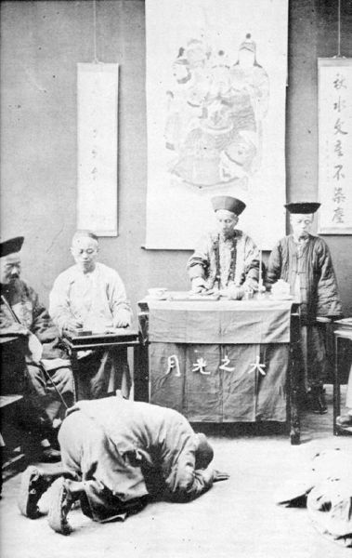
MANCHU DYNASTY
1644-1912: Manchuria (NE of Great Wall)
Took name of QING for their dynasty
Marked by isolationism until Dutch then British arrived
Dutch traded w/Manchu successfully
British refused to “kow tow” to Emperor

Slide 29
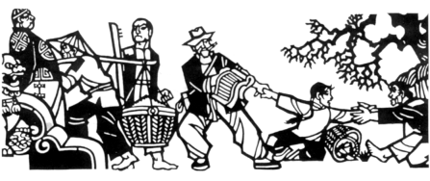
OPIUM WARS
By 1835 opium was used for non-medicinal purpose….
1839 war breaks
  China vs. Britain
  Old ships vs. new ships
  Losers vs. winners
  RESULT: unequal treaties, granting extraterritoriality, sphere of influence
  TREATY OF NANJING : HONG KONG TO Great Britain

Slide 30
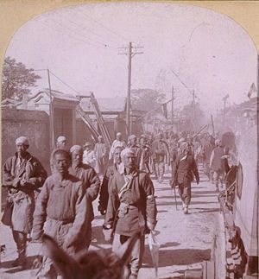
NATIONALISM
1800s: TAIPING REBELLION
  People angry that Manchu do not kick out foreigners
  Means “great peace”
Late 19th century:
  Spheres of influence
  European nations and Japan held exclusive trading rights
  US declares Open Door Policy
1899: BOXER REBELLION
  Rebelled against Open Door Policy and foreign influence
  “Death to the foreign devils”

Slide 31
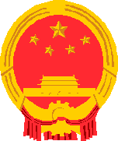
NATIONALISTS VS. COMMUNISTS
NATIONALISTS
KUOMINTANG
1911 dynastic rule ends
Civil war breaks out
Nationalists try to unify China : SUN YAT SEN
JIANG JIESHI takes over Nationalist cause after Sun’s death
Will fight with Mao
LOSER: flees to Taiwan
COMMUNISTS
  Group: Marx, Confucius
Led by MAO ZE DONG
LONG MARCH 6,000 miles long under fire by the Kuomintang
Peasant Support b/c land reform
1949 MAO controls CHINA

Slide 32
MAO ZEDONG
GREAT LEAP FORWARD
  Collectivization
  Creation of COMMUNES
  Increased standard of living
  Decline of traditional family
LITTLE RED BOOK
  Guide to Mao’s Communist China
CULTURAL REVOLUTION
  Red Guards given power to carry out Mao’s wishes
  Eliminate Opposition
  Closed schools and ordered intellectuals to countryside

Slide 33
China 1970’s to Present
Mao Succeeded by Deng Xiaoping (1978- 1992)
Opened up slightly to the west
Economic growth, flexibility, capitalism (free enterprise)
Foreign investment encouraged
Union with US to balance Soviet power (self-interest)
Increased Trade
FOUR MODERNIZATIONS
  Science and Technology
  Agriculture
  Industrialization
  Defense

Slide 34
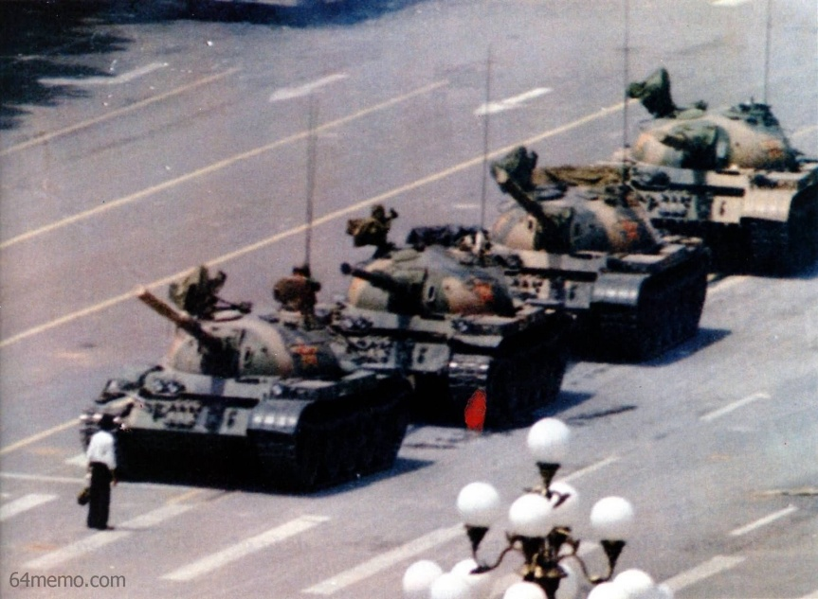
Tiananmen Square Massacre (1989)
Influenced by Western Ideas
Introduced reforms
Result= restrictions of freedoms

Slide 35
MODERN ISSUES
POPULATION
  ONE CHILD POLICY
  CROWDED IN THE EAST
SLOW INTRODUCTION OF CAPTIALISM
ECONOMIC INTERDEPENDENCE AND CHINA
THE ISSUE OF TIBET

