Slide 1
How did Government Intervene?
Industrialization

Slide 2
What was the government’s attitude towards business during the Gilded Age?

Slide 3
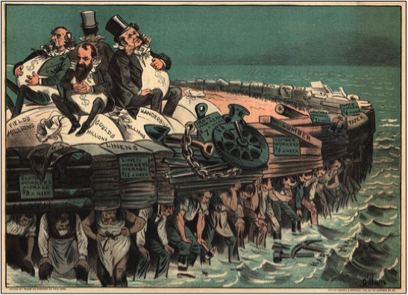
What Changed the Government’s Mind?
Increasing grassroots movement for change
Growing criticism of practices
Profit at what expense?
The Government impact was limited, but set the stage for federal actions to come.

Slide 4
Munn v Illinois (1877)
Facts of the Case
State of Illinois regulated grain warehouse and elevator rates, establishing maximum rates for their use.
The owners sues claiming that they should be able to decide how much they should charge for their services
Question Raised
Did the states imposed rates deny the warehouse and elevator owners equal protection and due process under the 14th Amendment?
Court Decision
No. The Court ruled that the Constitution recognized a state can regulate private property that affects “public interest”

Slide 5
Wabash, St. Louis, & Pacific R.R.
v Illinois (1886)
Facts of the Case
An Illinois statute imposed a penalty on railroads that charged the same or more money for passengers or freight shipped for shorter distances than for longer distances. The railroad in this case charged more for goods shipped from Gilman, Illinois, to New York, than from Peoria, Illinois, to New York, when Gilman was eighty six miles closer to New York than Peoria. applied to the intrastate (within one state) portion of an interstate (two or more states) journey.
Question Raised
Does a state government have the power to regulate railroad prices on that portion of an interstate journey that lies within its borders?

Slide 6
Wabash, St. Louis, & Pacific R.R.
v Illinois (1886)
Court Decision
Invalidated the state law setting railroad rates on interstate part of the trip
By declaring federal power to regulate rates and by limiting state regulations, the Court strengthened the Constitution’s Interstate Commerce Law
Paved the Way for the Interstate Commerce Commission in 1887

Slide 7
Landmark Antitrust Legislation
Interstate Commerce Commission (ICC)-1887
A federal group created by Congress to oversee and correct abuses in the railroad industry
Sherman Antitrust Act-1890
Outlawed any combination of companies that restrained trade or commerce

Slide 9
United States v E.C. Knight Co. (1895)
Facts of the Case
American Sugar bought out four other sugar refineries, increasing its control over national sugar production to 98 percent. In response, the U.S. government sought to invalidate American Sugar's purchase in a lower federal court on the grounds that it violated the Sherman Act.
Question Raised
Did Congress exceed its constitutional authority under the Commerce Clause when it enacted the Sherman Anti-Trust Act?
Court Decision
The Sherman Anti-Trust Act did not apply to manufacturing because the manufacturing of refined sugar was confined within a single state (8-1 decision)
Manufacturing operations are not "interstate commerce," the Court asserted, because such operations occur entirely in one state. In short, Congress has the power to regulate trade but not manufacturing.

